Slide 1


How to implement Map Function in Hybird?
By Richard Jiang
The future is present -----Mobile Team

Slide 2
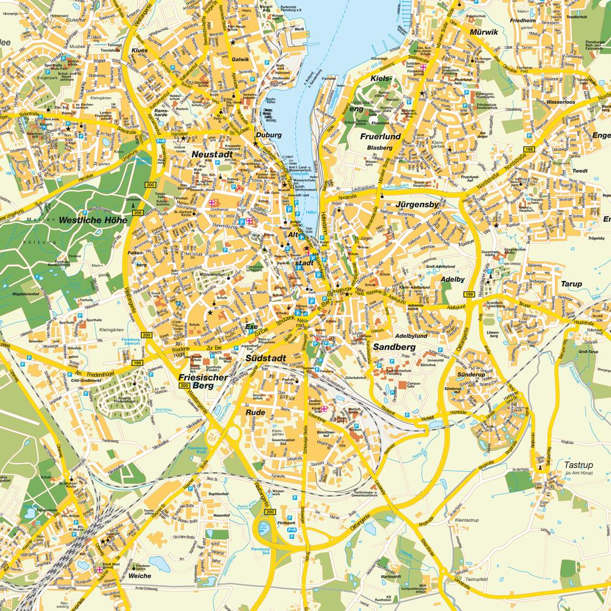
Solutions For Map
Made by Native, write the plugin for this
Call JS library to implement it.

Slide 3

Implement it by Baidu Map JS Library.
Easy to integrate with hybird app.
Do not need to wirte plugin for this.
Can work on different platforms.

Slide 4
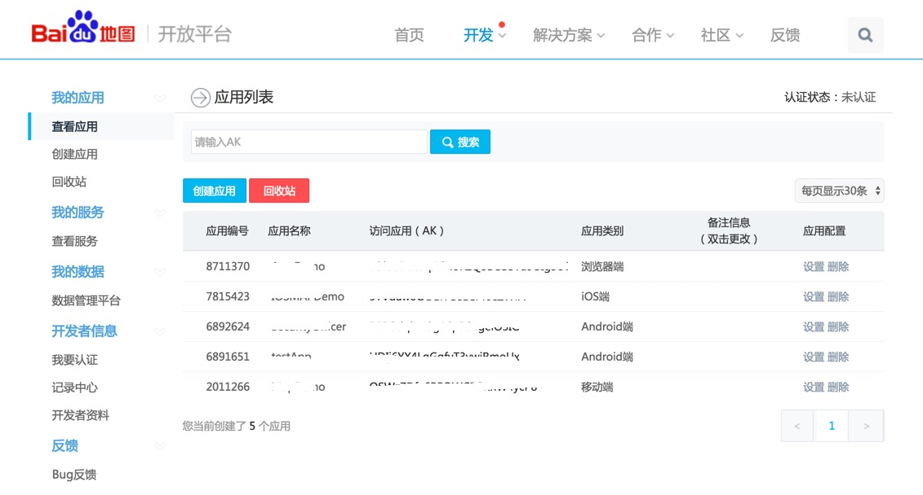
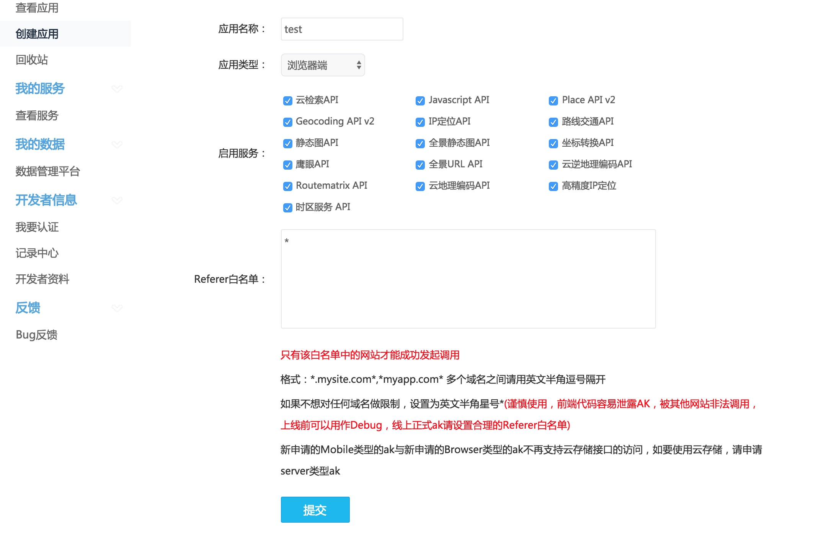
Register App For Hybird Applicaation
http://lbsyun.baidu.com/apiconsole/key

Slide 5
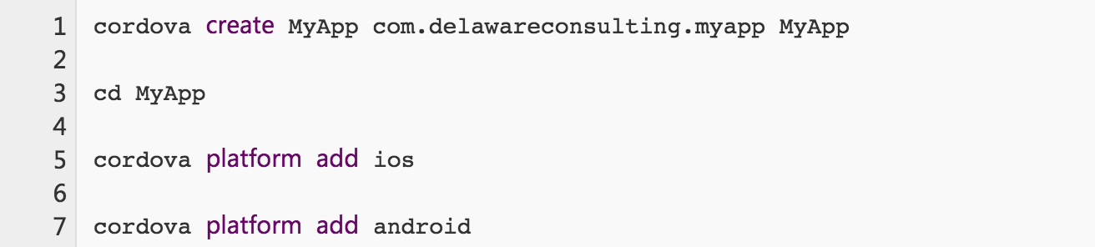
To Create Cordova Project
Note: if you only need one platform, you can add your necessary platform.

Slide 6
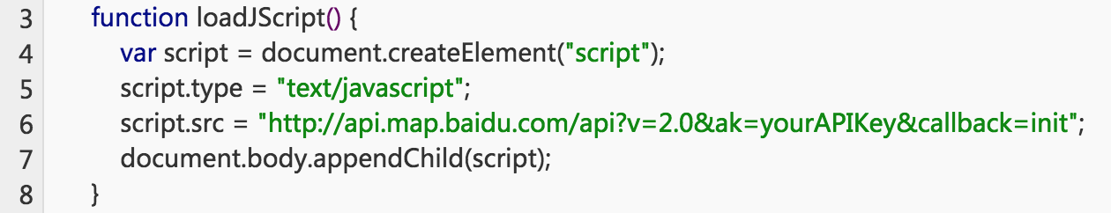
Add JS Library For Map
Import JQuery for test:
Async load Baidu library:

Slide 7
Canvas route path
var map = new BMap.Map("allmap"); // 创建Map实例
var start = "哈尔滨";
var end = "百度大厦";
map.centerAndZoom(new BMap.Point(116.404, 39.915), 11);
map.clearOverlays();
var driving = new BMap.DrivingRoute(map,
{renderOptions:{map: map, autoViewport: true},
policy: BMAP_DRIVING_POLICY_LEAST_TIME});
driving.search(start,end);

Slide 8
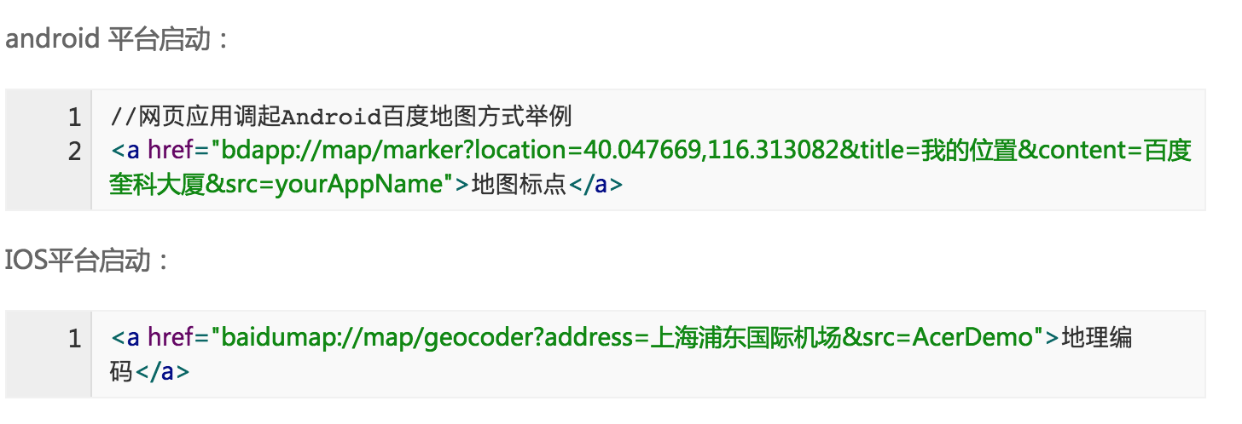
Map Navigation

Slide 9
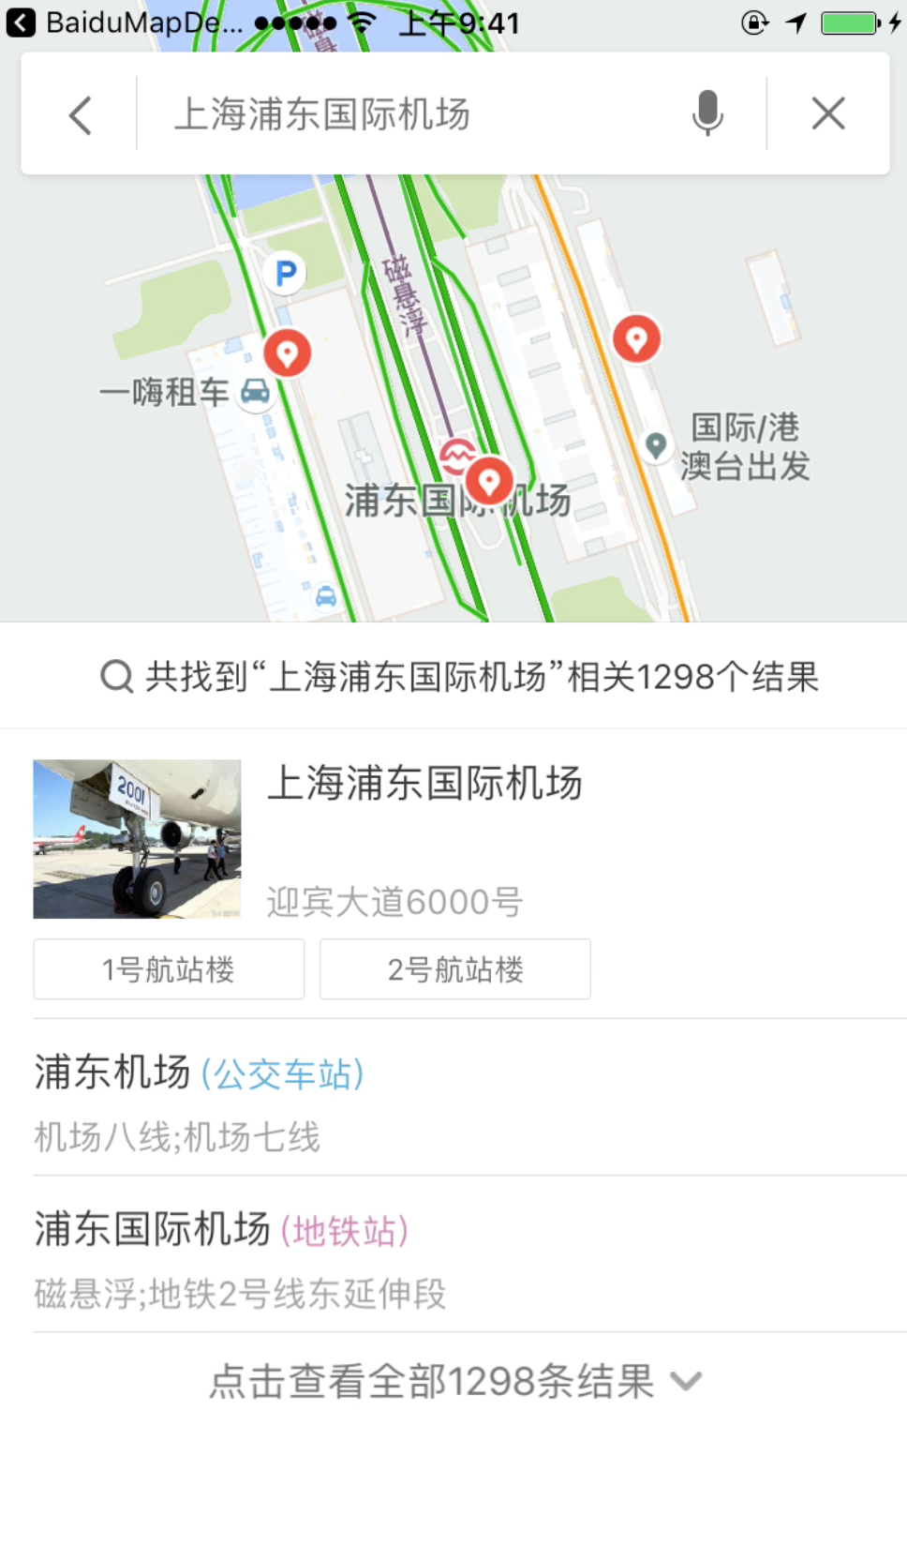

Configure Cordova
Note: to configure the open external link permission.

Slide 10
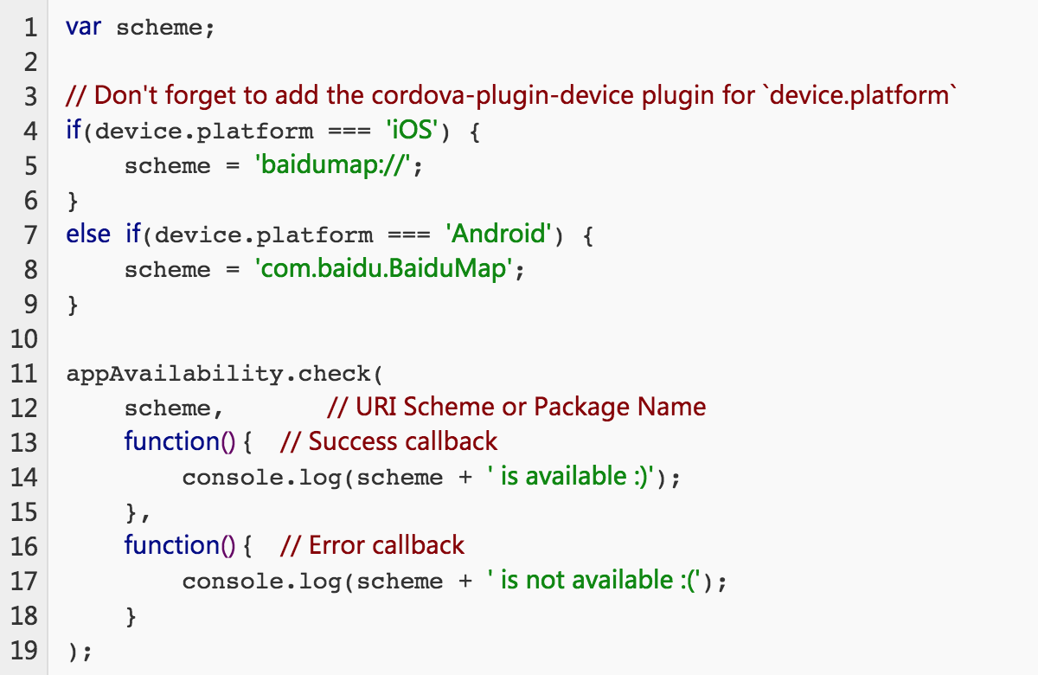
To check Baidu App exist

Slide 11
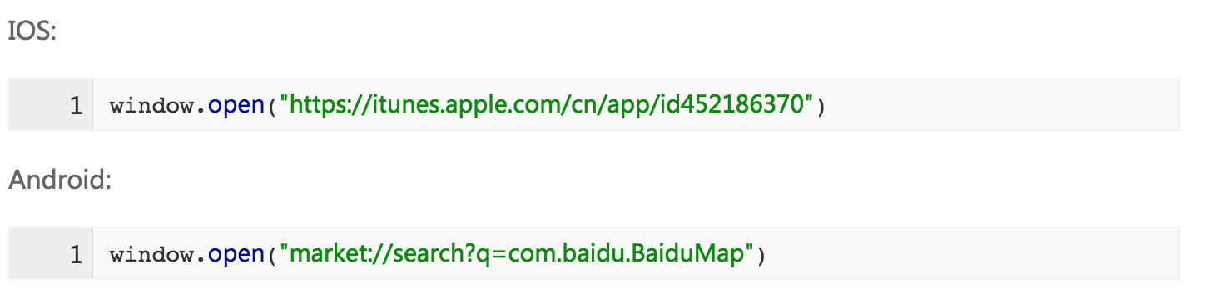
Open link to download baidu map app

Slide 12


